Slide 1
Relational Model
Codd proposed the relational data model in 1970
The relational model is very simple and elegant
novice users to understand the contents of a database, and it permits the use of simple, high-level languages to query the data
The major advantages
simple data representation and
the ease with which even complex queries can be expressed

Slide 2
The main construct for representing data in the relational model is a relation
Relational database: a set of relations
Relation: made up of 2 parts:
Schema : specifies name of relation, name and type of each column and the domain of that each column.
E.G. Students(sid: string, name: string, login: string,age: integer, gpa: real).

Slide 3
Instance : a table, with rows and columns. #Rows = cardinality, #fields = degree / arity.
An instance of a relation is a set of rows or tuples also called as records (i.e., all rows are distinct)

Slide 4
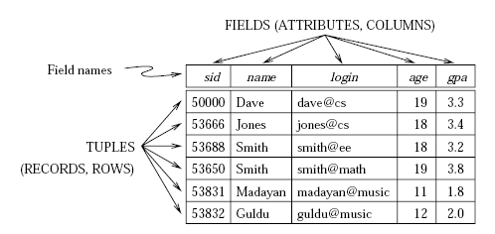
A relational database is a collection of relations with distinct relation names
The relational database schema is the collection of schemas for the relations in the database

Slide 5
Relational Query Languages
Queries can be written intuitively, and the DBMS is responsible for efficient evaluation

Slide 6
SQL(Structured Query Language)
Developed by IBM (system R) in the 1970s
Need for a standard since it is used by many vendors
Standards:
SQL-86
SQL-89 (minor revision)
SQL-92 (major revision, current standard)
SQL-99 (major extensions)

Slide 7
Creating and Modifying Relations Using SQL
Creating Relations
CREATE TABLE <name> ( <field> <domain>, … );
CREATE TABLE Students(sid CHAR(20), name CHAR(20), login CHAR(10),age INTEGER, gpa REAL) ;
insert the tuples in the table
INSERT INTO <name> (<field names>) VALUES (<field values>);
INSERT INTO Students (sid, name, login, age, gpa)VALUES (‘53688’, ‘Smith’, ‘smith@ee’, 18, 3.2);

Slide 8
delete a tuple from the table
DELETE FROM <name> WHERE <condition>
DELETE FROM Students S WHERE S.name = ‘Smith’
UPDATE the column values in an existing row
UPDATE <name> SET <field name> = <value> WHERE <condition>
UPDATE Students set age=20 where sid=53666;

Slide 9
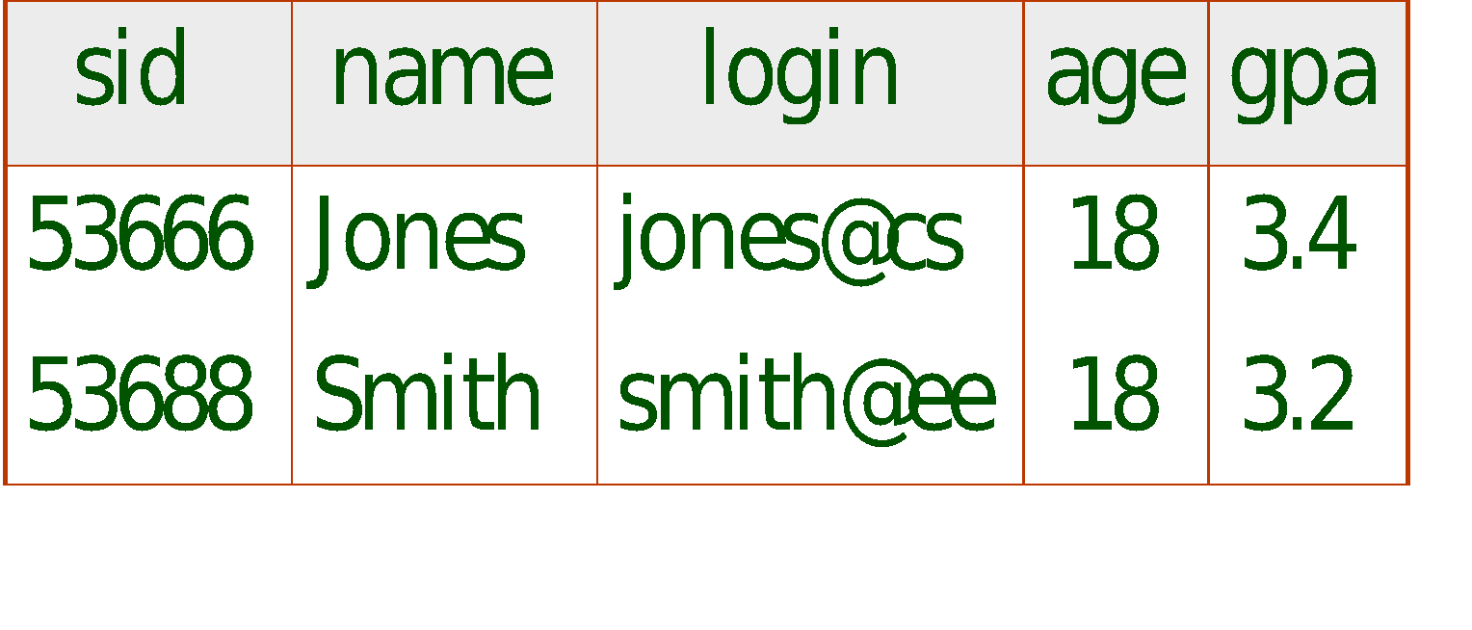
SELECT <fields> FROM <name> WHERE <condition>
SELECT * FROM Students S WHERE S.age=18

Slide 10
Integrity Constraints
An integrity constraint (IC) is a condition that is specified on a database schema, and restricts the data that can be stored in an instance of the database
If a database instance satisfies all the integrity constraints specified on the database schema, it is a legal instance
A DBMS enforces integrity constraints, in that it permits only legal instances to be stored in the database

Slide 11
Integrity constraints are specified and enforced at different times
When the DBA or end user defines a database schema, he or she species the ICs that must hold on any instance of this database
When a database application is run, the DBMS checks for violations and disallows changes to the data that violate the specified Ics

Slide 12
Key Constraints
A key constraint is a statement that a certain minimal subset of the fields of a relation is a unique identifier for a tuple
A set of fields that uniquely identifies a tuple according to a key constraint is called a candidate key for the relation

Slide 13
There are two parts to the definition
Two distinct tuples in a legal instance cannot have identical values in all the fields of a key
No subset of the set of fields in a key is a unique identifier for a tuple
sid is a key for Students
{sid, gpa} is a superkey.

Slide 14
Primary Key
Enrolled(sid: string, cid: string, grade: string)
For a given student and course, there is a single grade
CREATE TABLE Enrolled (sid CHAR(20) , cid CHAR(20),
grade CHAR(2), PRIMARY KEY (sid,cid) );
Students can take only one course, and receive a single grade for that course; further, no two students in a course receive the same grade
CREATE TABLE Enrolled (sid CHAR(20) cid CHAR(20), grade CHAR(2), PRIMARY KEY (sid), UNIQUE (cid, grade));

Slide 15
Foreign key
Foreign key : Set of fields in one relation that is used to `refer’ to a tuple in another relation.
Must correspond to primary key of the second relation.
Like a `logical pointer’.
If one of the relations is modified, the other must be checked, and perhaps modified, to keep the data consistent
If all foreign key constraints are enforced, referential integrity is achieved, i.e., no dangling references.

Slide 16
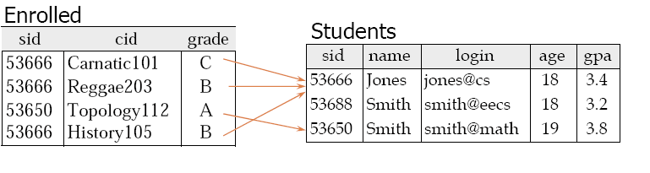
Only students listed in the Students relation should be allowed to enroll for courses
CREATE TABLE Enrolled (
sid CHAR(20),
cid CHAR(20),
grade CHAR(2),
PRIMARY KEY (sid,cid),
FOREIGN KEY (sid) REFERENCES Students);

Slide 17
The foreign key constraint states that every sid value in enrolled must also appear in Students, that is, sid in Enrolled is a foreign key referencing Students

Slide 18
ENFORCING INTEGRITY CONSTRAINTS
Consider Students and Enrolled; sid in Enrolled is a foreign key that references Students.
What should be done if an Enrolled tuple with a non-existent student id is inserted? (Reject it!)
What should be done if a Students tuple is deleted?
Also delete all Enrolled tuples that refer to it.
Disallow deletion of a Students tuple that is referred to.
Set sid in Enrolled tuples that refer to it to a default sid.
(In SQL, also: Set sid in Enrolled tuples that refer to it to a special value null, denoting `unknown’ or `inapplicable’.)
Similar if primary key of Students tuple is updated.

Slide 19
ENFORCING INTEGRITY CONSTRAINTS
INSERT INTO Students (sid, name, login, age, gpa) VALUES (53688, `Mike', `mike@ee', 17, 3.4);
violates the primary key constraint as duplicates are not allowed
INSERT INTO Students (sid, name, login, age, gpa) VALUES (null, `Mike', `mike@ee', 17, 3.4)
violates the constraint that the primary key cannot contain null:
UPDATE Students S SET S.sid = 50000 WHERE S.sid = 53688
violates the constraint

Slide 20
Consider Students and Enrolled; sid in Enrolled is a foreign key that references Students
What should be done if an Enrolled tuple with a non-existent student id is inserted?
Disallow deletion of a Students tuple that is referred to
Set sid in Enrolled tuples that refer to it to a default sid.

Slide 21
Referential Integrity in SQL/92
CREATE TABLE Enrolled (
sid CHAR(20) default ‘11111’,
cid CHAR(20),
grade CHAR(2),
PRIMARY KEY (sid,cid),
FOREIGN KEY (sid)
REFERENCES Students
ON DELETE CASCADE
ON UPDATE SET DEFAULT )
NO ACTION, which means that the action (DELETE or UPDATE) is to be rejected
CASCADE keyword says that if a Students row is deleted, all Enrolled rows that refer
to it are to be deleted as well.
If a Students row is deleted, we can switch the enrollment to a `default' student by using
ON DELETE SET DEFAULT.

Slide 22
QUERYING RELATIONAL DATA
A relational database query is a question about the data, and the answer consists of a new relation containing the result
SQL is the most popular commercial query language for a relational DBMS
A major strength of the relational model:
supports simple,
powerful querying of data.

Slide 23


We can retrieve rows corresponding to students who are younger than 18 with the following SQL query
SELECT * FROM Students S WHERE S.age < 18
SELECT S.name, S.login
FROM Students S
WHERE S.age < 18

Slide 24
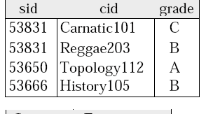

We can also combine information in the Students and Enrolled relations
SELECT S.name, E.cid
FROM Students S, Enrolled E
WHERE S.sid = E.sid AND E.grade = `A'
Given the following instance of Enrolled
we get:

Slide 25
Semantics of a Query
A conceptual evaluation method for the previous query:
1. do FROM clause: compute cross-product of Students and Enrolled
2. do WHERE clause: Check conditions, discard tuples that fail
3. do SELECT clause: Delete unwanted fields

Slide 26
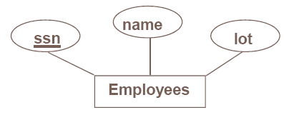
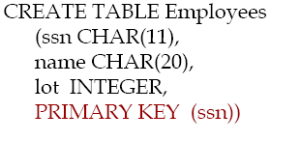
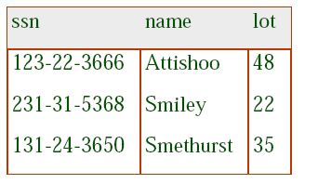
Logical DB Design: ER to Relational
Entity sets to tables

Slide 27
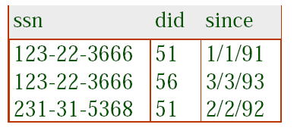
Relationship Sets(Without constraints) to Tables
In translating a relationship set to a relation, attributes of the relation must include:
Keys for each participating entity set (as foreign keys).
This set of attributes forms a superkey for the relation.
All descriptive attributes
CREATE TABLE Works_In(
ssn CHAR(1),
did INTEGER,
since DATE,
PRIMARY KEY (ssn, did),
FOREIGN KEY (ssn)
REFERENCES Employees,
FOREIGN KEY (did)
REFERENCES Departments)

Slide 28
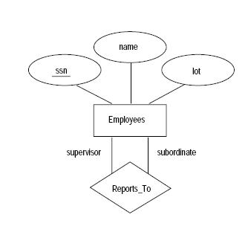
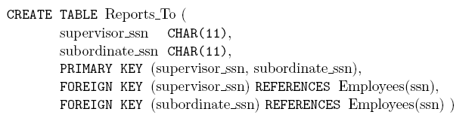

Slide 29
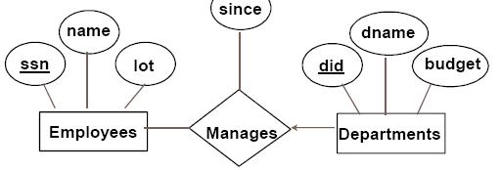
Key Constraints
CREATE TABLE Manages(
ssn CHAR(11),
did INTEGER,
since DATE,
PRIMARY KEY (did),
FOREIGN KEY (ssn) REFERENCES Employees,
FOREIGN KEY (did) REFERENCES Departments)

Slide 30
CREATE TABLE Dept_Mgr(
did INTEGER,
dname CHAR(20),
budget REAL,
ssn CHAR(11),
since DATE,
PRIMARY KEY (did),
FOREIGN KEY (ssn) REFERENCES Employees

Slide 31
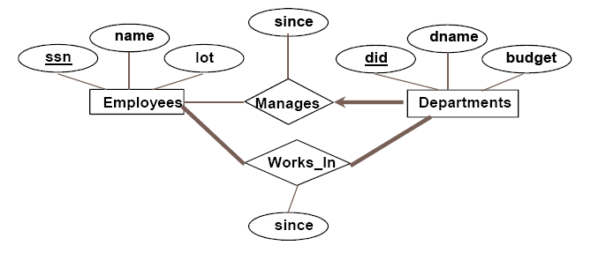
Participation Constraints
Does every department have a manager?
If so, this is a participation constraint: the participation of Departments in Manages is said to be total (vs. partial).
Every did value in Departments table must appear in a row of the Manages table (with a non-null ssn value!)

Slide 32
We can capture participation constraints involving one entity set in a binary relationship
CREATE TABLE Dept_Mgr(
did INTEGER,
dname CHAR(20),
budget REAL,
ssn CHAR(11) NOT NULL,
since DATE,
PRIMARY KEY (did),
FOREIGN KEY (ssn) REFERENCES Employees,
ON DELETE NO ACTION)

Slide 33
Weak Entities
A weak entity can be identified uniquely only by considering the primary key of another (owner) entity.
Owner entity set and weak entity set must participate in a one -to- many relationship set (1 owner, many weak entities).
Weak entity set must have total participation in this identifying relationship set.

Slide 34
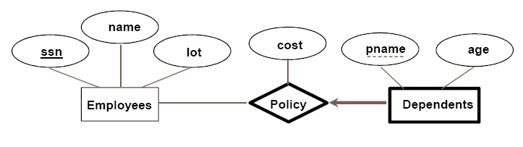
Weak entity set and identifying relationship set are translated into a single table.
When the owner entity is deleted, all owned weak entities must also be deleted.
CREATE TABLE Dep_Policy (
pname CHAR(20),
age INTEGER,
cost REAL,
ssn CHAR(11) NOT NULL,
PRIMARY KEY (pname, ssn),
FOREIGN KEY (ssn) REFERENCES Employees,
ON DELETE CASCADE)

Slide 35
ISA Hierarchies
3 relations: Employees, Hourly_Emps and Contract_Emps.
Hourly_Emps: Every employee is recorded in Employees. For hourly emps, extra info recorded in Hourly_Emps(hourly_wages, hours_worked, ssn); must delete Hourly_Emps tuple if referenced Employees tuple is deleted
Alternative: Just Hourly_Emps and Contract_Emps.
Hourly_Emps: ssn, name, lot, hourly_wages, hours_worked.
Each employee must be in one of these two subclasses.

